Slide 1
CoVid-19
LESSON 2: What to do if you get sick & 30 days to slow the spread
Find Press it to turn red when you aren’t talking.
Have a paper and pencil ready to use
HEALTH LITERACY WORK GROUP

Slide 2
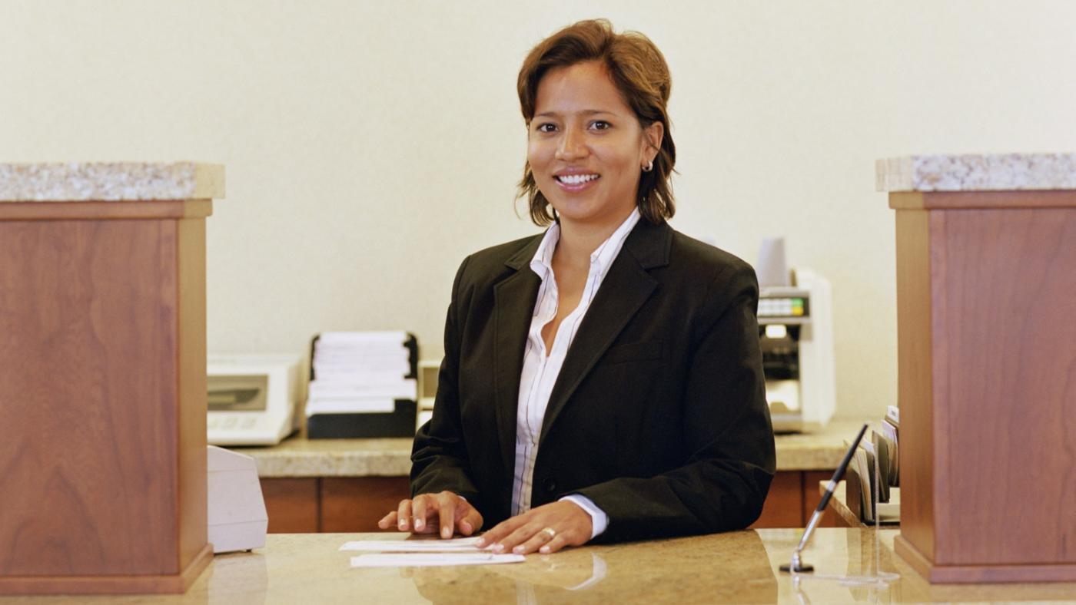
30 days to slow the spread. Juanita & Frank
Remember Juanita? She works in a bank. She lives with her husband, Frank; her 65-year old mother, Teresa; and her 10-year old daughter, Mary. Juanita and Frank watched the president and health officials the other night talk about the new plan “30 Days to Slow the Spread” They think this means they should continue social distancing and staying at home as much as they can. But they did not understand some of what was said. They also don’t understand why they have to keep doing this.
Remember that that CoVid-19 is a “novel” or new virus. Experts are still learning about it and in a pandemic they will ask us to learn new things too.
Let’s look at some of the science words in this announcement so we can all learn and do what will help!

Slide 3
Now let’s Look at some science words (let’s read them together and I will explain them)
Model: a picture showing something that is hard to understand.
Projection or trajectory: looking forward in time at what is likely to happen based on what has already happened. Often part of a model.
Community Spread: When a virus spreads from one person to other people within a community.
Community Mitigation: When a community works together to prevent many people from getting sick.

Slide 4
Matching
When a community works together to
prevent many people from getting sick
A virus spreads from one person to
other people inside a community
Community Mitigation
Projection or trajectory
Model
Community spread
Looking forward in time at what is likely to happen based on what has already happened.
A picture showing something that is hard to understand

Slide 5
“Flattening the Curve”

Slide 6
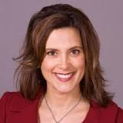
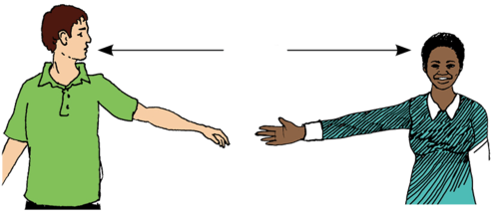
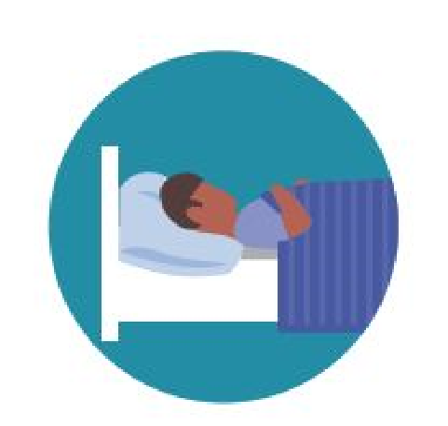
30 days to Slow the Spread
Follow directions of the state and community
Practice social distancing
Stay home as much as possible
Stay home if you or someone in your family is sick
Hesperian, 2020-https://en.hesperian.org/hhg/Coronavirus

Slide 7
What to do if you feel sick? Juanita’s Dilemma
The day after hearing the president Juanita went to work at the bank. She started coughing at work and she felt hot. She looked at the CoVid-19 poster on the wall at the bank. She saw that coughing, a fever, and shortness of breath are symptoms of the virus. Her boss told her to go home. She knows if her mother caught CoVid-19 she could get very sick. Maybe she should go to her doctor or to the hospital instead.
She goes to the Center for Disease Control (CDC) website and reads:
“Stay in touch with your doctor. Call before you get medical care”.

Slide 8
Juanita Finds Some Answers
Juanita calls her doctor. He says she may have CoVid-19 but it is very mild. He tells her to go home to rest and call him tomorrow to let him know how she is. Then he will decide if she needs to get tested. She says she is worried about her mother. He tells her how to protect her mother and sends her back to the CDC website to help her remember what to do. This is where he sends her.
https://www.cdc.gov/coronavirus/2019-ncov/downloads/10Things.pdf
Before we see what Juanita found out let’s look at the words we need.

Slide 9
Here are some important words (let’s read them together)
Monitor: to check on something often (taking your temperature to see if it changes)
Hydrated: keeping water in your body to help fight a virus
Separate (“SEH-puh-rate”) = (verb) to divide; to move away from: “Separate yourself from the family. Stay in different bedrooms.”
Separate (“SEH-pruht”) = (adjective) divided; away from: “Use separate bathrooms. Use a different bathroom.”
Worse: more “bad” than before

Slide 10
Fill in the Blank a. monitor b. separate (SEH pur-ra’te) c. separate (SEH-pruht) d. hydrated e. worse
Stay in a _______________ bedroom.
Call the Dr. if you symptoms get __________.
__________ your symptoms.
Drink water to make sure your body is _________.
______________ yourself from other family members.

Slide 11
Let’s Look at the website the Dr. sent Juanita to:
https://www.cdc.gov/coronavirus/2019-ncov/downloads/10Things.pdf

Slide 12
1. public/avoid/transportation/using
Avoid using public transportation.
2. provider/worse/symptoms/healthcare/your/if/get/call/your
If your symptoms get worse call your healthcare provider.
3. people/from/stay/other/away
Stay away from other people.
4. sharing/avoid/items/personal
Avoid sharing personal items.
5. face/a/wear/mask
Wear a face mask.

Slide 13
Juanita wants to know:
What kind of symptoms would be an emergency
This is what the CDC site says:
“Seek Medical Attention Immediately If you have:
Trouble breathing
Persistent pain or pressure in the chest
New confusion or inability to arouse
Bluish lips or face
*Please consult your medical provider for any other symptoms that are severe or concerning.”

Slide 14
Juanita doesn’t know what these words mean
The CDC site says: “Emergency Warning Signs for CoVid-19”
Seek Medical Attention Immediately If you have:
Trouble breathing
Persistent pain or pressure in the chest
New confusion or inability to arouse
Bluish lips or face
*Please consult your medical provider for any other symptoms that are severe or concerning.

Slide 15
Juanita looked up the words and this is what they mean
Immediately : right away. “Do it right now!”
Persistent pain: Pain that is always there, you can’t get rid of it.
Unable to arouse: can’t wake someone up.
Consult: To talk to about a problem “Consult with the Dr.”

Slide 16
Matching
To talk to about solving a problem
Pain that is always there, you can’t get rid of it.
Right now
Can’t wake someone up
Immediately
Persistent pain
Unable to arouse.
Consult

Slide 17
What to do? Use “Chat” to write your answer
What does it mean to “Seek Medical Attention Immediately”? How do we seek emergency medical attention in our country?

Slide 18
What to Do When Someone is Sick

Slide 19
Juanita will follow the CDC advice. How will that protect her mother? Unmute your microphone to answer?
She will not be in the same room as her mother
She will not use the same things as her mother
Only her husband will come to her if she needs help
She will wear a face mask if her husband is in the room or she needs to go out
Everyone in the family will wash their hands frequently
Her husband will disinfect surfaces at least once a day

Slide 20
Homework: Make a plan for your house in case someone gets sick
Where can the sick person stay to be as far away from the rest of the people living there.
Make sure to have soap and disinfectant.
Make sure everyone knows how to wash their hands right and practices not touching their face.
Look for two or three cloth face masks. Can you sew some faces masks or ask someone to do it for you? If not have some bandanas you can use to block sneezes.

Slide 21
Questions from last week
Pets and CoVid-19.
Facemasks

Slide 22
What questions do you have about COVID-19?
Go to the top of your screen and open the chat . Write down one or two questions that you have. We will work to include them in our series on this coronavirus.

Slide 23
Next Coronavirus Topic: How do I use the computer to talk to a health care provider? & the CARES act
Remember you can work with your tutor before the next time. No tutor? Call the Kalamazoo Literacy Council at (269) 382-0490 ext. 222.
Best websites for the coronavirus:
https://www.cdc.gov/coronavirus/2019-nCoV/index.html
https://www.who.int/emergencies/diseases/novel-coronavirus-2019

Slide 24
Stay Home and Stay Healthy!
Developed by:
Dr. Doris Ravotas
Fulbright Specialist
Master Faculty Specialist
School of Interdisciplinary Health Programs
College of Health and Human Services
KLC Fellow and Health Literacy Work Group Leader
Email: doris.ravotas@wmich.edu
HEALTH LITERACY WORK GROUP

